Slide 1
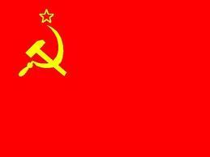
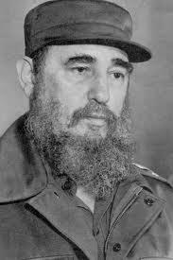
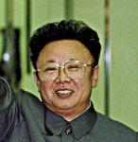
The Influence of Communism
Which countries in the world were communist?
Which countries are currently communist?

Slide 2
Introductory Terms
authoritarian system –
a system of government in which power is concentrated in the hands of one political party or small group of leaders.
Communism –
a system of government in which only one party, the communist party, governs. The party’s stated ideological goals are “Marxism” (economic egalitarianism) and strives to achieve this through a command economy. The only way to advance in society is through the party (nomenklatura), and party membership is strictly limited to the elite (top 5%).

Slide 3
Introductory Terms (part 2)
Karl Marx-
a German philosopher who predicted that, after industrialization, countries would go through a wrenching change (the dialectic). Workers would not accept low wages and would demand a share of profits, overthrowing wealthy business owners and creating a classless society (historical materialism).
Democratic Centralism-
Governing principle of communist systems of government. Literally means “democracy at the center” allowing debate among party elites. After policy decisions are made, no dissent is tolerated.

Slide 4
Economic System - Comparison
Command economy –
an economic system in which the central government plans the amount of goods to be produced (usually in a five year plan) and sets wages for workers and prices for goods. The state employs workers and controls all means of producing goods (private entrepreneurs are not allowed).
Market economy –
an economic system in which prices of goods and means a production are decided by the principles of supply and demand. Businesses are motivated by profit incentives and businesses are free to compete within a market.

Slide 5
COMMUNIST SYSTEMS OF GOVERNMENT
Party Control –
Political party controls all aspects of political, economic and social life. This includes all leadership positions, school curriculum, all retail sales, books, press, movement, professions, child rearing and all goods are communal. The communist party provides an “iron rice bow” (meaning government benefits) and a sense of stability.
Cult of Personality –
In most communist systems , citizens develop an extraordinary idolization of their leader which is exhibited through large statues/monuments/photos of the leader.
Top down political participation –
Top down political participation is defined as participation which is orchestrated from the top. Political leaders require citizens to demonstrate in favor of leadership or may require citizens to vote.

Slide 6
INSTITUTIONS OF GOVERNMENT IN COMMUNIST STATES Nomenklatura

Slide 7
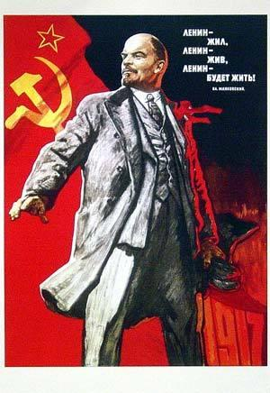
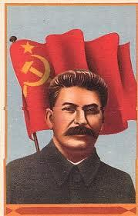
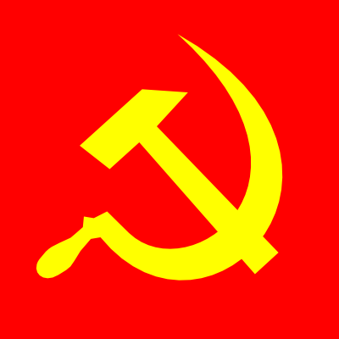
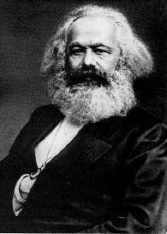
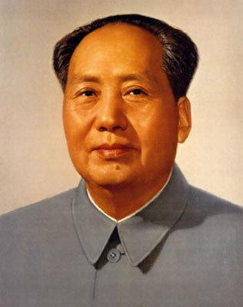
Complete - Comparing Democratic & Authoritarian Systems (Handout)

Slide 8
Let’s Compare What are the similarities? What are the differences.
Democracy
Authoritarian
Functions of Political Parties
Act as linkage institutions
Pick Candidates
Run campaigns
Give cues to voters
Articulate policies
Coordinate policymaking
Staff government
Mobilize the public
Act as loyal opposition
Functions of Political Parties

Slide 9
Let’s Compare
Democracy
Authoritarian
Forms of Political Participation
Voting
Protesting
Joining a party
Joining an interest group
Contacting a congressperson
Writing a letter to the editor
Running for office
Assisting in a campaign
Strikes/boycotts
Forms of Political Participation

Slide 10
Let’s Compare
Democracy
Authoritarian
Market Economy
Principles of supply and demand set prices for goods
Profit motive provides incentive for production
Is likely to result in unequal distribution of wealth
Government regulates some aspects of the economy
Command Economy

Slide 11
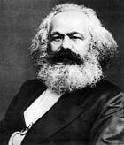
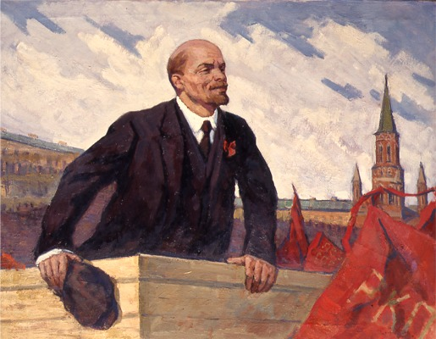
Marx and Communism
Manifesto!
Review the definitions of the following terms. Compare/contrast each term to check for understanding of similarities and differences.
Marxism
Marxism-Leninism
Communism
nomenklatura
Socialism
totalitarianism
.
Read excerpts from the “Communist Manifesto” by Karl Marx.
As you read you should answer the following questions:

Slide 12
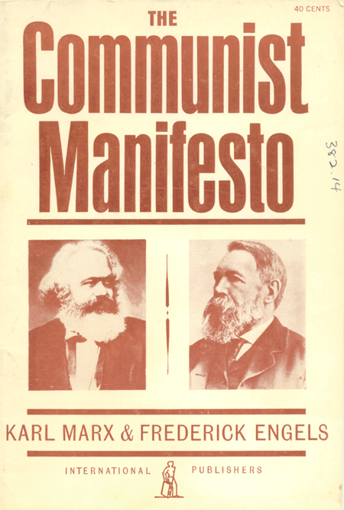
Communist Manifesto
The class struggle described by Marx exists between which groups?
Why does Marx say the bourgeoisie have the “upper hand”?
How does wage labor work?
What is political power according to Marx?
What will happen to it?
Under what conditions would communism be ideal?
Which nations did Marx see as ripe for Communism?

